Slide 1
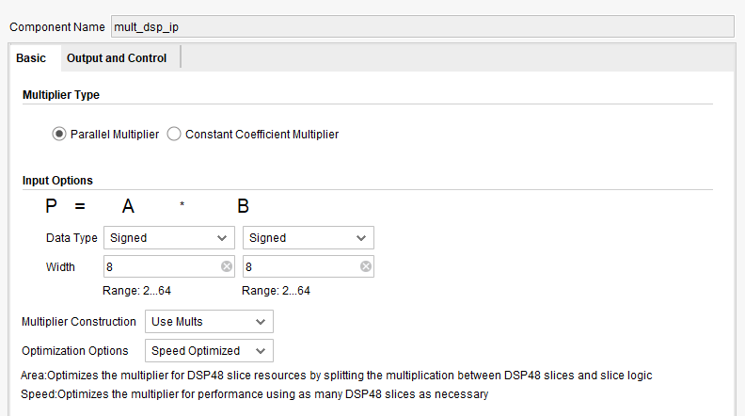
Single DSP Multiplier 3 stage pipeline
Setting:

Slide 2
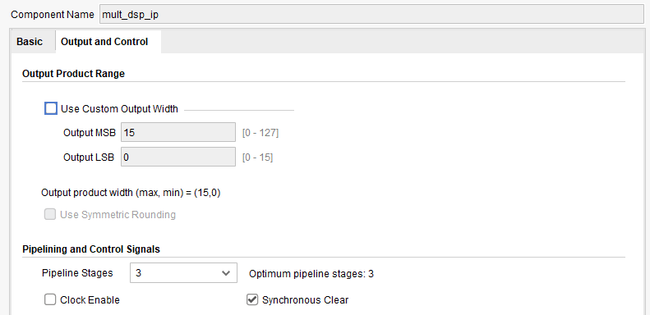
Single DSP Multiplier 3 stage pipeline
Setting:

Slide 3
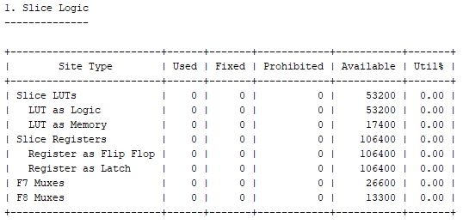
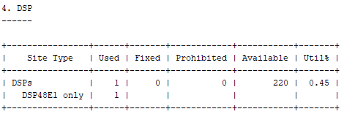
Single DSP Multiplier 3 stage pipeline
Hardware utilization:

Slide 4
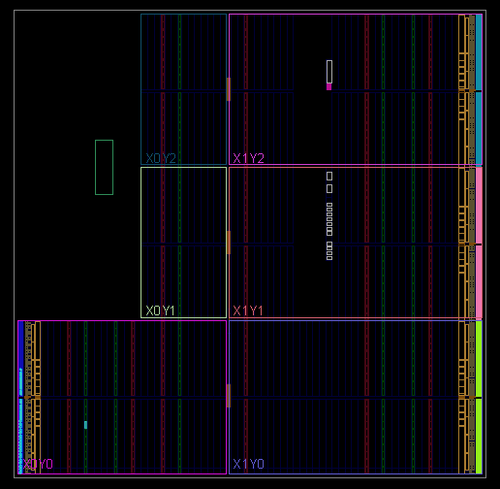
Single DSP Multiplier 3 stage pipeline
Hardware utilization:

Slide 5
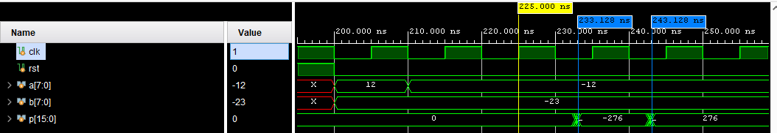
Single DSP Multiplier 3 stage pipeline
Waveform:

Slide 6
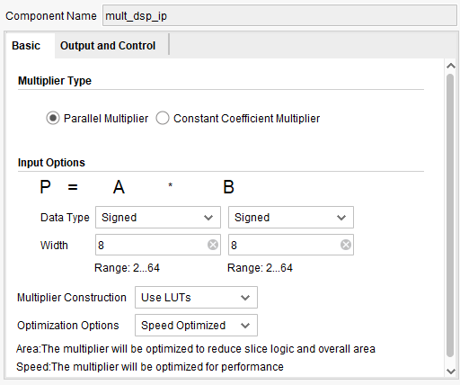
Single LUT Multiplier 3 stage pipeline
Setting:

Slide 7
Single LUT Multiplier 3 stage pipeline
Setting:

Slide 8
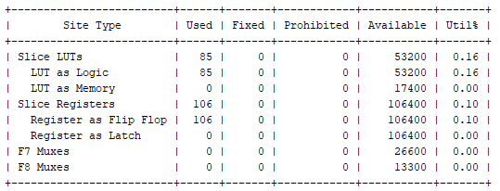
Single LUT Multiplier 3 stage pipeline
Hardware utilization:

Slide 9
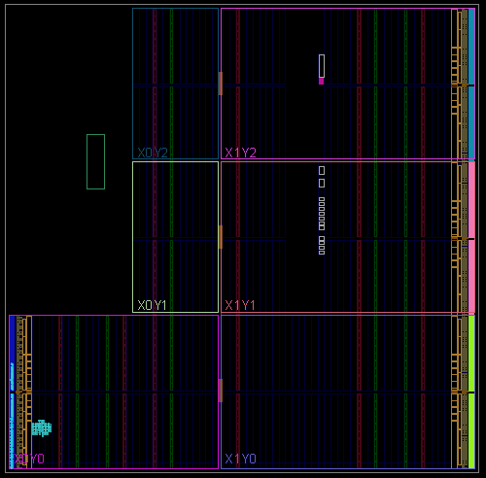
Single LUT Multiplier 3 stage pipeline
Hardware utilization:

Slide 10
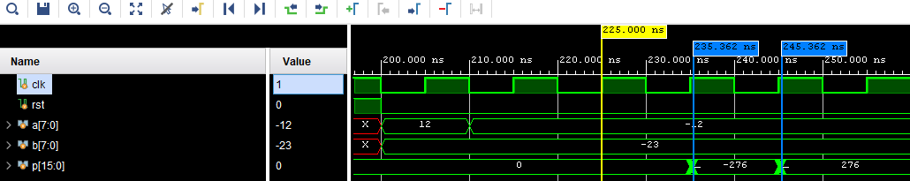
Single LUT Multiplier 3 stage pipeline
Waveform:

Slide 11
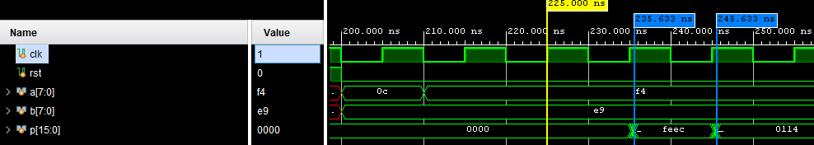
Single LUT Multiplier 3 stage pipeline
Waveform:

